Slide 1
WEATHER RADAR & FORECASTING APP
Group 4:
Aman Goyal (10676744)
Sobiya Duraichamy (10676818)
Madhavan Natarajan (10676825)
Pankaj Verma (10677024)

Slide 2
AGENDA
INTRODUCTION
TECHNOLOGY STACK
ARCHITECTURE
AWS SERVICES USED
APPLICATION DEVELOPMENT FLOW
WEBSITE WORKFLOW DIAGRAM
WEBSITE
SAMPLE ANALYSIS
FUTURE PROSPECTS

Slide 3
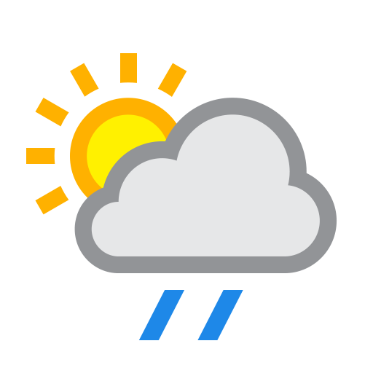
INTRODUCTION
Weather Radar and Forecasting app is a state of the art, one stop destination for users to get the weather related information for present as well as future time.
Statistics included: Present Temperature: Actual/FeelsLike, Humidity, Temperature range, UV Index, Weather conditions, 5 day forecast.
To consume the user data, we’ve included a survey form to get some thought provoking insights over different types of user data, e.g. User profession, topography, Gender and the purpose behind the search.

Slide 4




TECHNOLOGY STACK

Slide 5
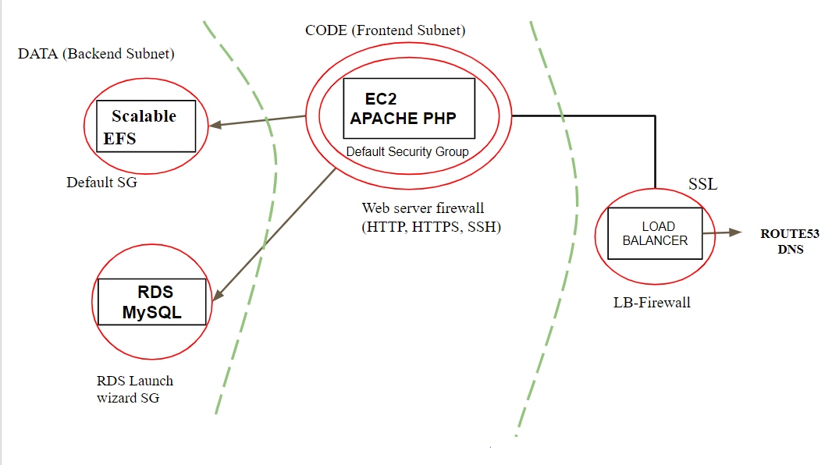
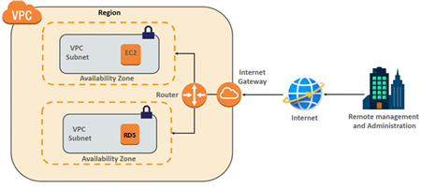
ARCHITECTURE
Front End Subnet
Back End Subnet
Fig. SUB DIVISIONS IN ARCHITECTURE
Fig. FLOW OF REQUESTS

Slide 6
AWS SERVICES USED
IAM (Identity and Access Management system) – Roles & Policies.
VPC (Virtual Private Cloud) – Subnets, Route tables & Gateways.
EC2 (Elastic Compute Cloud) – Instances(VMs), Security Groups, Load Balancer & EBS Volumes.
EFS – Elastic File Storage.
RDS – Relational Database Service.
S3 – Simple Storage Service.
Route53 – Domain Name System Web Service.
AWS Certificate Manager – Amazon Security Certificate.
AWS Glue – ETL Tool.
Amazon Redshift – Data Warehouse.
Quick Sight – BI Tool.

Slide 7
APPLICATION DEVELOPMENT FLOW
Project Development: Weather app, Survey form, Admin Portal Creation & Migration to S3.
AWS Architecture Setup, Planning and Project Requirement Analysis.
Conducted Survey and Analysis over User Data.
DAY 1,2,3
DAY 4,5
DAY 5,6,7
DAY 8,9
DAY 7
DAY 10,11
Alpha & Beta Testing and Deployment.
UI design & Prototyping.

Slide 8
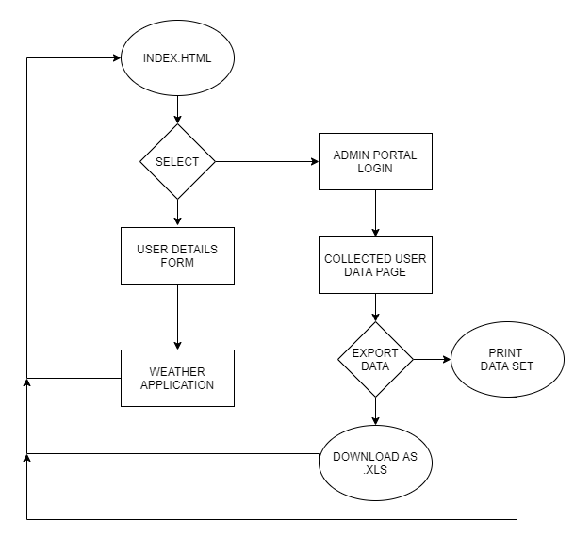
WEBSITE WORKFLOW DIAGRAM

Slide 9
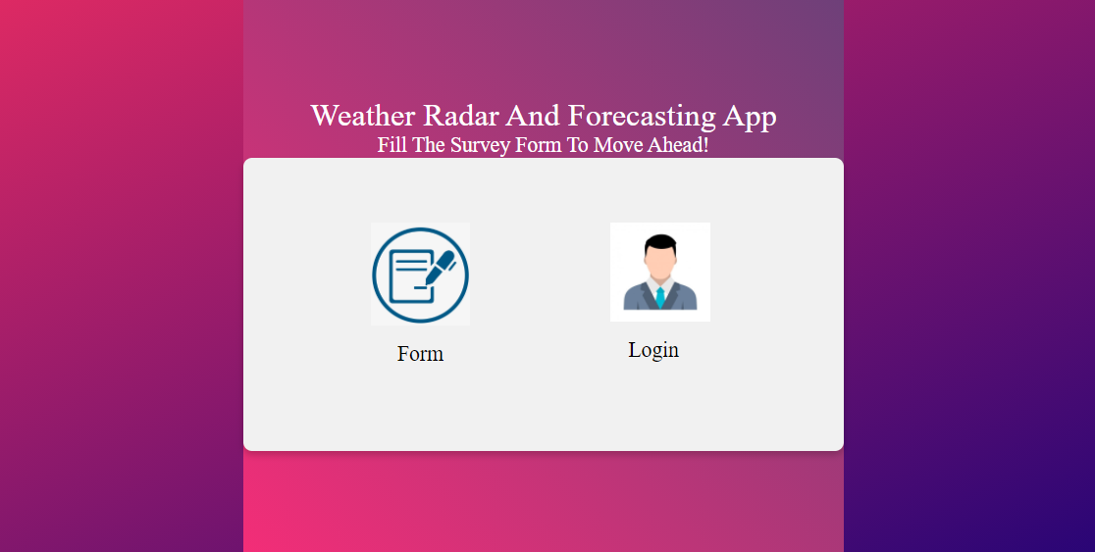
WEBSITE
INDEX PAGE

Slide 10
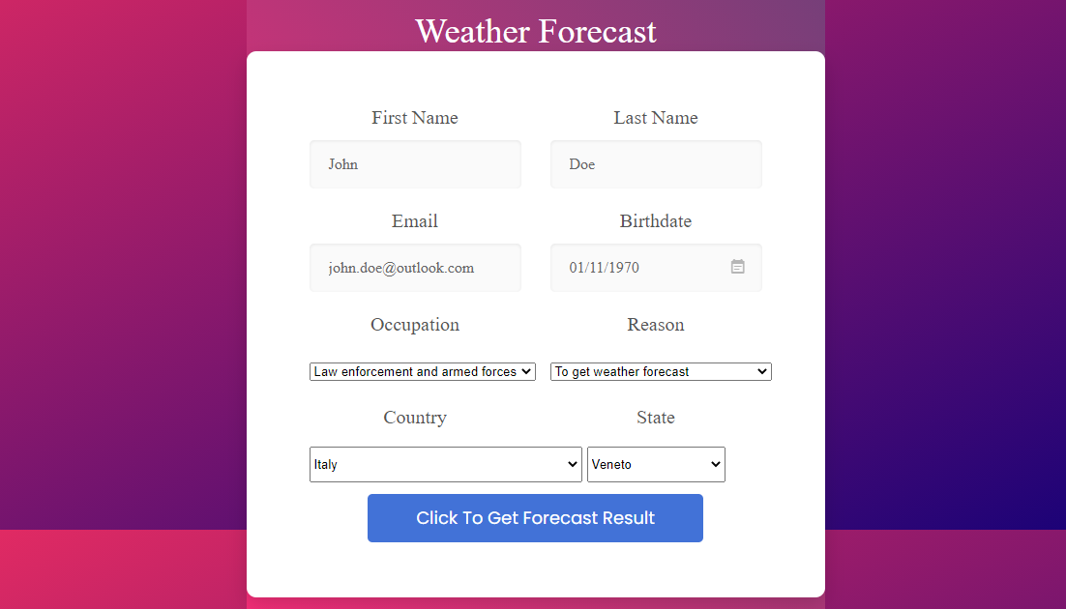
WEBSITE
SURVEY FORM

Slide 11
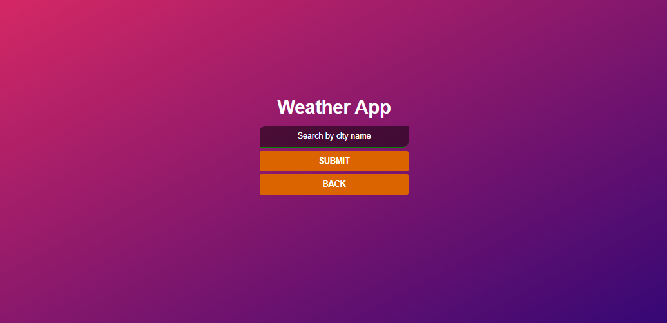
WEBSITE
WEATHER APP

Slide 12
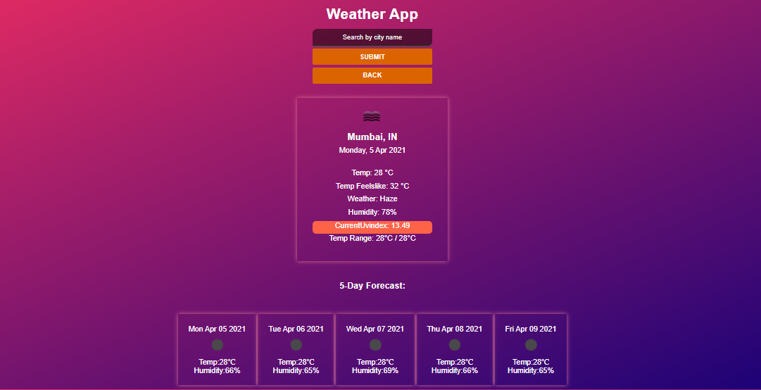
WEBSITE
WEATHER APP

Slide 13
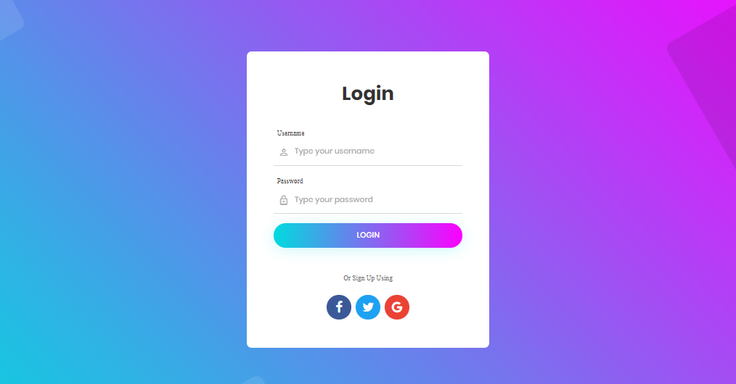
WEBSITE
ADMIN PORTAL

Slide 14
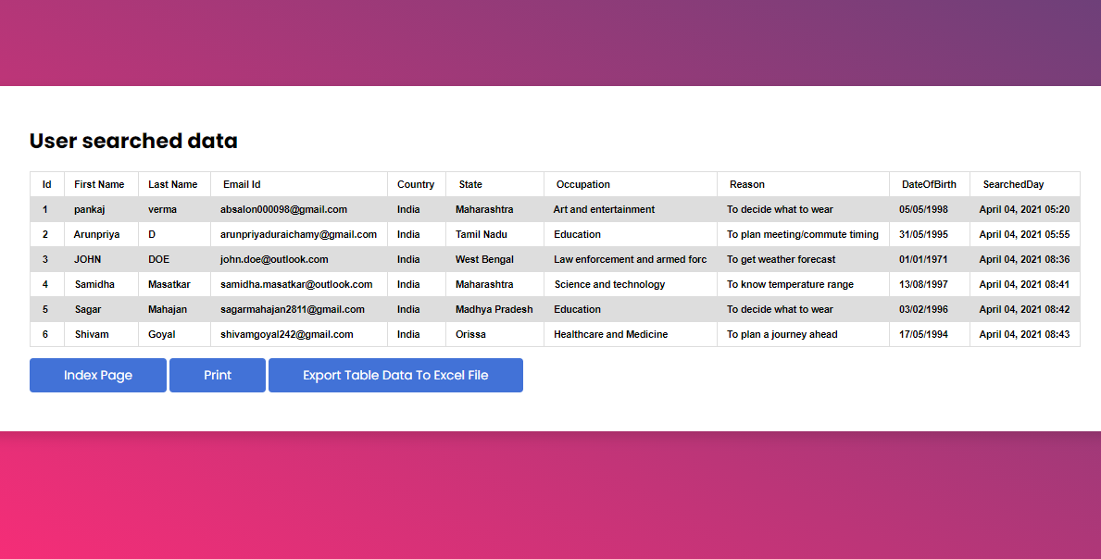
WEBSITE
DATABASE

Slide 15
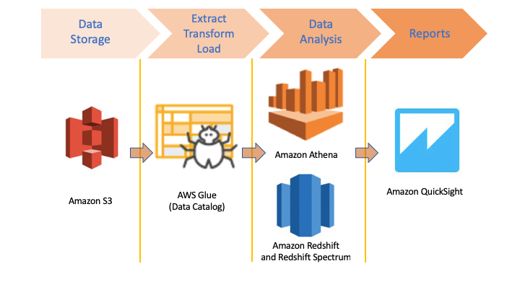
DATA ANALYSIS AND REPORTS GENERATION
WORK FLOW

Slide 16
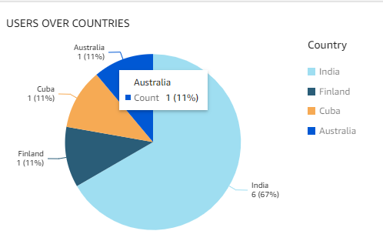
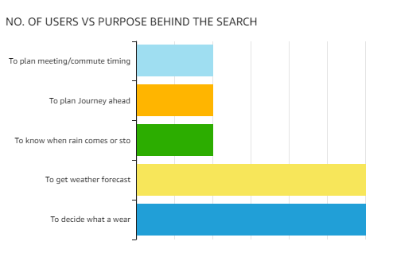
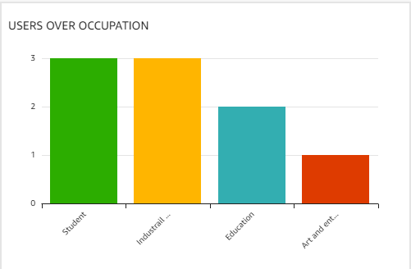
SAMPLE ANALYSIS OVER USER DATA
USING AWS QUICKSIGHT

Slide 17
FUTURE PROSPECTS
This application can be extended to include hourly forecasts.
Graphs can be included representing variations in temperature.
Searched City Data with user consent can also be stored in Database, same can be used for generating better insights.
The Weather application currently uses a single source for weather data, this data can also be sourced from multiple sources to get better accuracy.
The data can also be exported to various other formats.
Monetisation can also be done to generate revenue.

Slide 18
THANK YOU.

